Slide 1
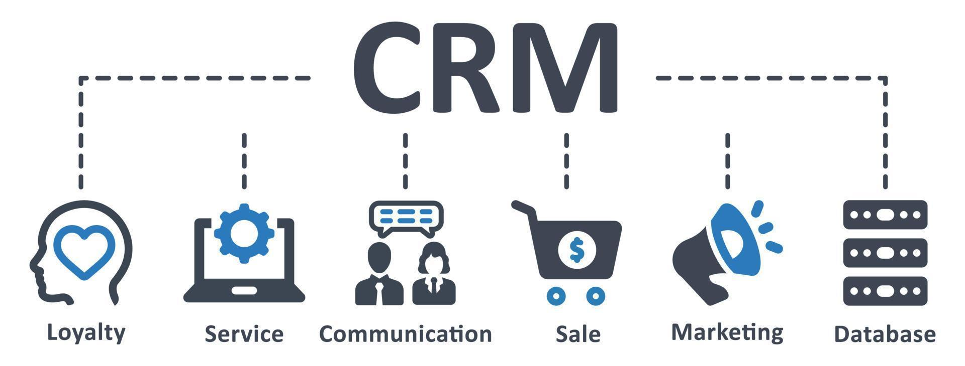
Salesforce Analytics Discovering New Opportunities With Advanced Insights
A Data-Driven Analysis Using Excel Power BI and Tableau
Presented By:
SHAZIA
SHIKHA
SURIYA
MAHESH KHANDGAVE
VIJAY REDDY

Slide 2

INTRODUCTION
Axon is a growing retail and consumer products company.
The company uses Salesforce CRM to manage sales activities and customer relationships.
Salesforce captures data related to leads, accounts, opportunities, and revenue.
With increasing sales data, manual analysis becomes time-consuming and inefficient.
Sales Analytics helps transform raw Salesforce data into meaningful insights.
The goal is to improve sales performance, pipeline visibility, and decision-making.

Slide 3
KPIs & INSIGHTS:
KPI | Excel | Power BI | Tableau
Total Leads | Included | 10K | 10K
Conversion Rate | 1,033 | 1,033 | 1,033
Lead Sources | __ | 27 | 491K
Total Opportunities | Included | 4.65K | 4,648
Won by Opportunity | __ | 1.446K | 1,446
KPI | Excel | Power BI | Tableau
Produced Qty | 60,022.5K | 60M | 60,051K
Processed Qty | 49,790.6K | — | 60,023K
Rejected Qty | 491K | 491K | 491K
Orders / Buyers | 9,944 | Included | Included
Rejection % | — | 0.01% | Included

Slide 4
Insights:
Lead Dashboard Insights
A total of 10K leads were generated, showing strong lead inflow.
Lead creation is highest during mid-year months, indicating seasonal demand.
Website and Webinar are the top-performing lead sources, contributing maximum leads.
A majority of leads are in Converted and Working status, reflecting good lead quality.
Only a small portion of leads are marked as Dead or Not Contacted, indicating effective follow-ups.
Certain industries contribute more leads, highlighting high-potential industry segments.
Opportunity Dashboard Insights
The total opportunity value is 4.65K, with a significant number of won opportunities.
Most opportunities are concentrated in specific industries, showing targeted sales success.
Closed-Won and Closed-Lost stages hold the largest share, indicating clear deal outcomes.
Opportunities are distributed across multiple countries, with key contribution from top regions.
COVID impact analysis shows that most opportunities were not significantly affected, ensuring business continuity.

Slide 5
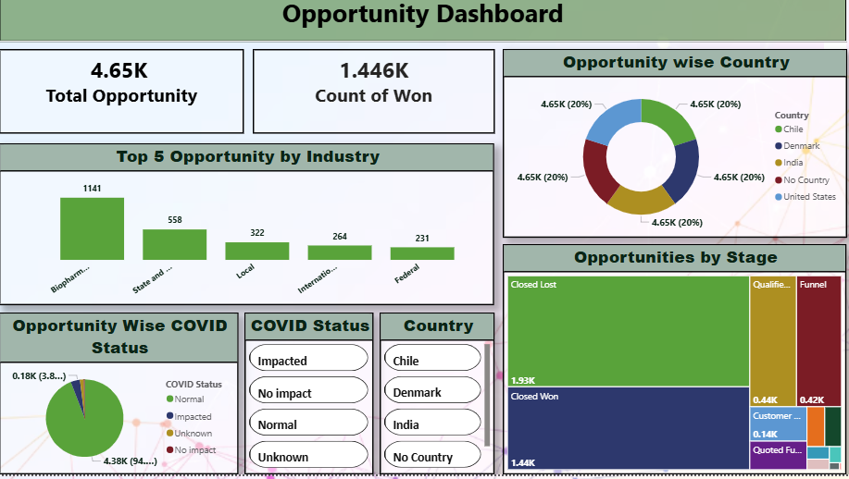
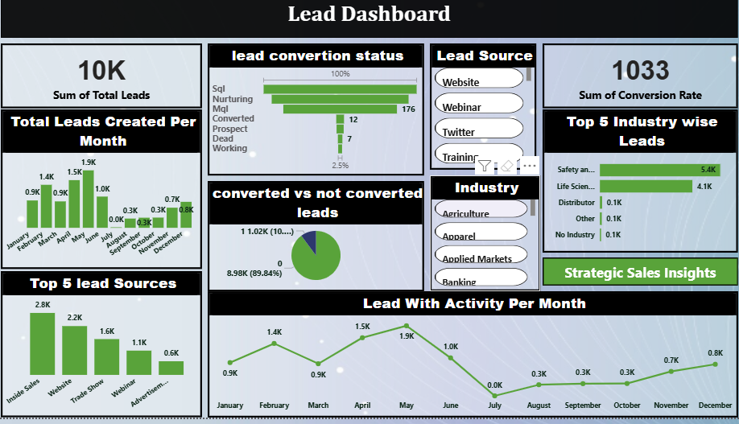
POWER BI DASHBOARD:

Slide 6
Power BI Dashboard Overview:
Total Leads (10K): Displays the total number of leads generated during the selected period.
Total Opportunities (4.65K): Represents the total opportunities created from converted leads.
Count of Won Opportunities (1.446K): Shows the number of successfully closed deals.
Conversion Rate (1033): Indicates overall effectiveness of lead-to-opportunity conversion.
Converted vs Not Converted Leads (Donut Chart): Provides a clear comparison of successful and unsuccessful lead conversions

Slide 7
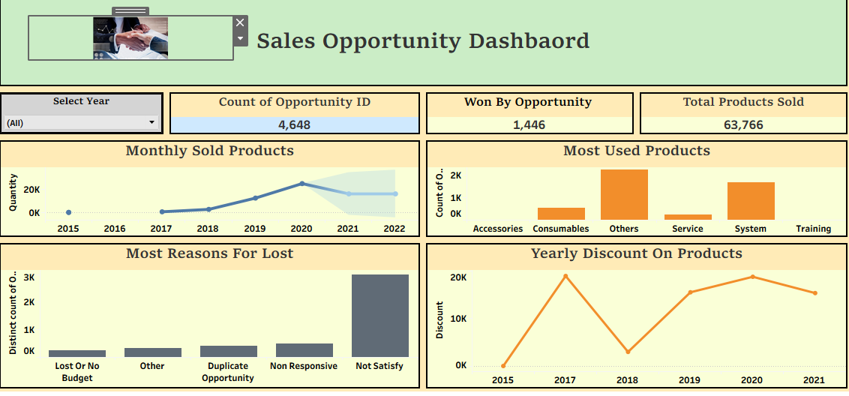
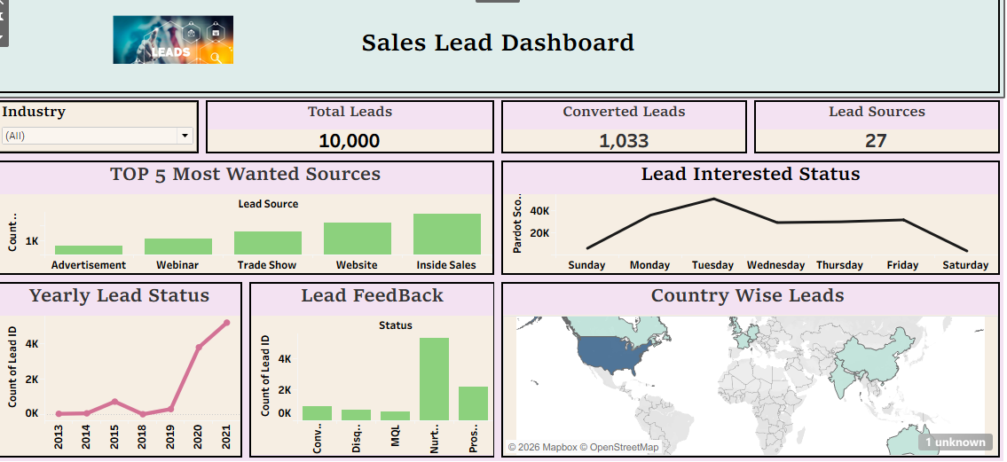
TABLEAU DASHBOARD:

Slide 8
Tableau Dashboard Overview:
LEADS : Displays Total Leads (10,000) and Converted Leads (1,033) to track lead performance.
Shows Yearly Lead Status to analyze lead trends over different years.
Top 5 Most Wanted Lead Sources identify high-performing sources such as Website, Advertisement, and Trade Shows.
Lead Feedback and Lead Interested Status help understand customer engagement and interest levels.
OPPORTUNITIES : Displays Total Opportunities (4,648) and Won Opportunities (1,446) for sales performance tracking.
Monthly Sold Products chart shows sales trends across years.
Most Used Products highlights products with highest demand such as Systems and Services.
Yearly Discount on Products helps analyze the impact of discounts on sales.
​
​ ​

Slide 9
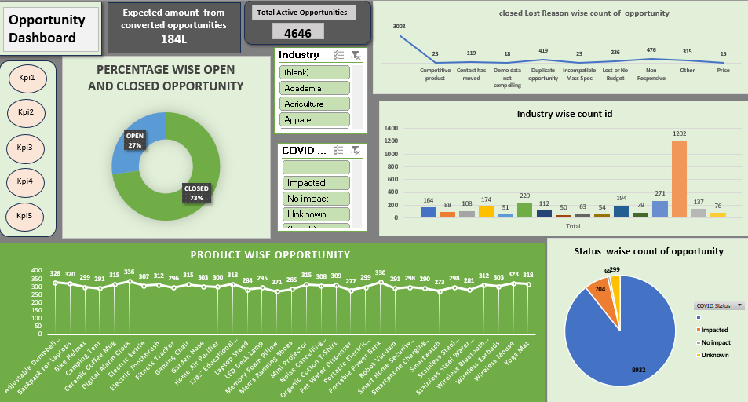
EXCEL DASHBOARD:

Slide 10
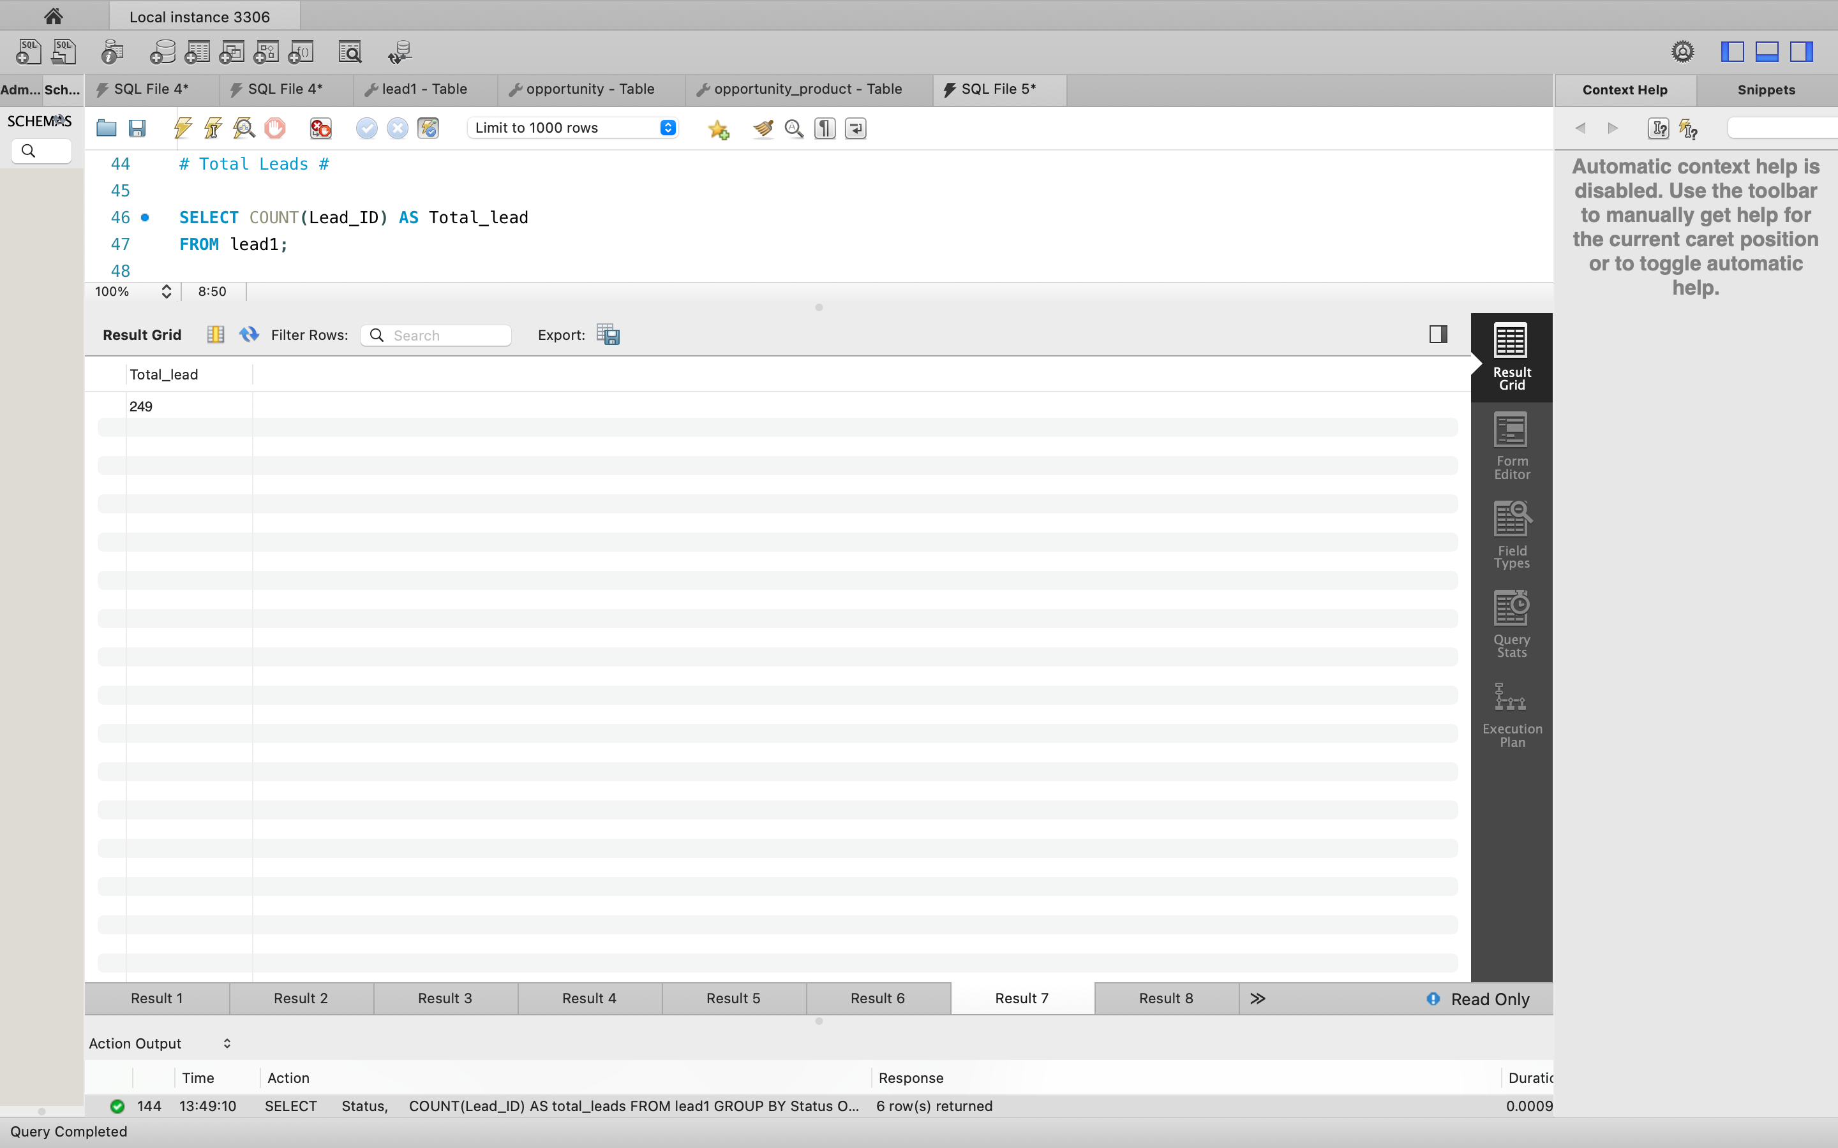
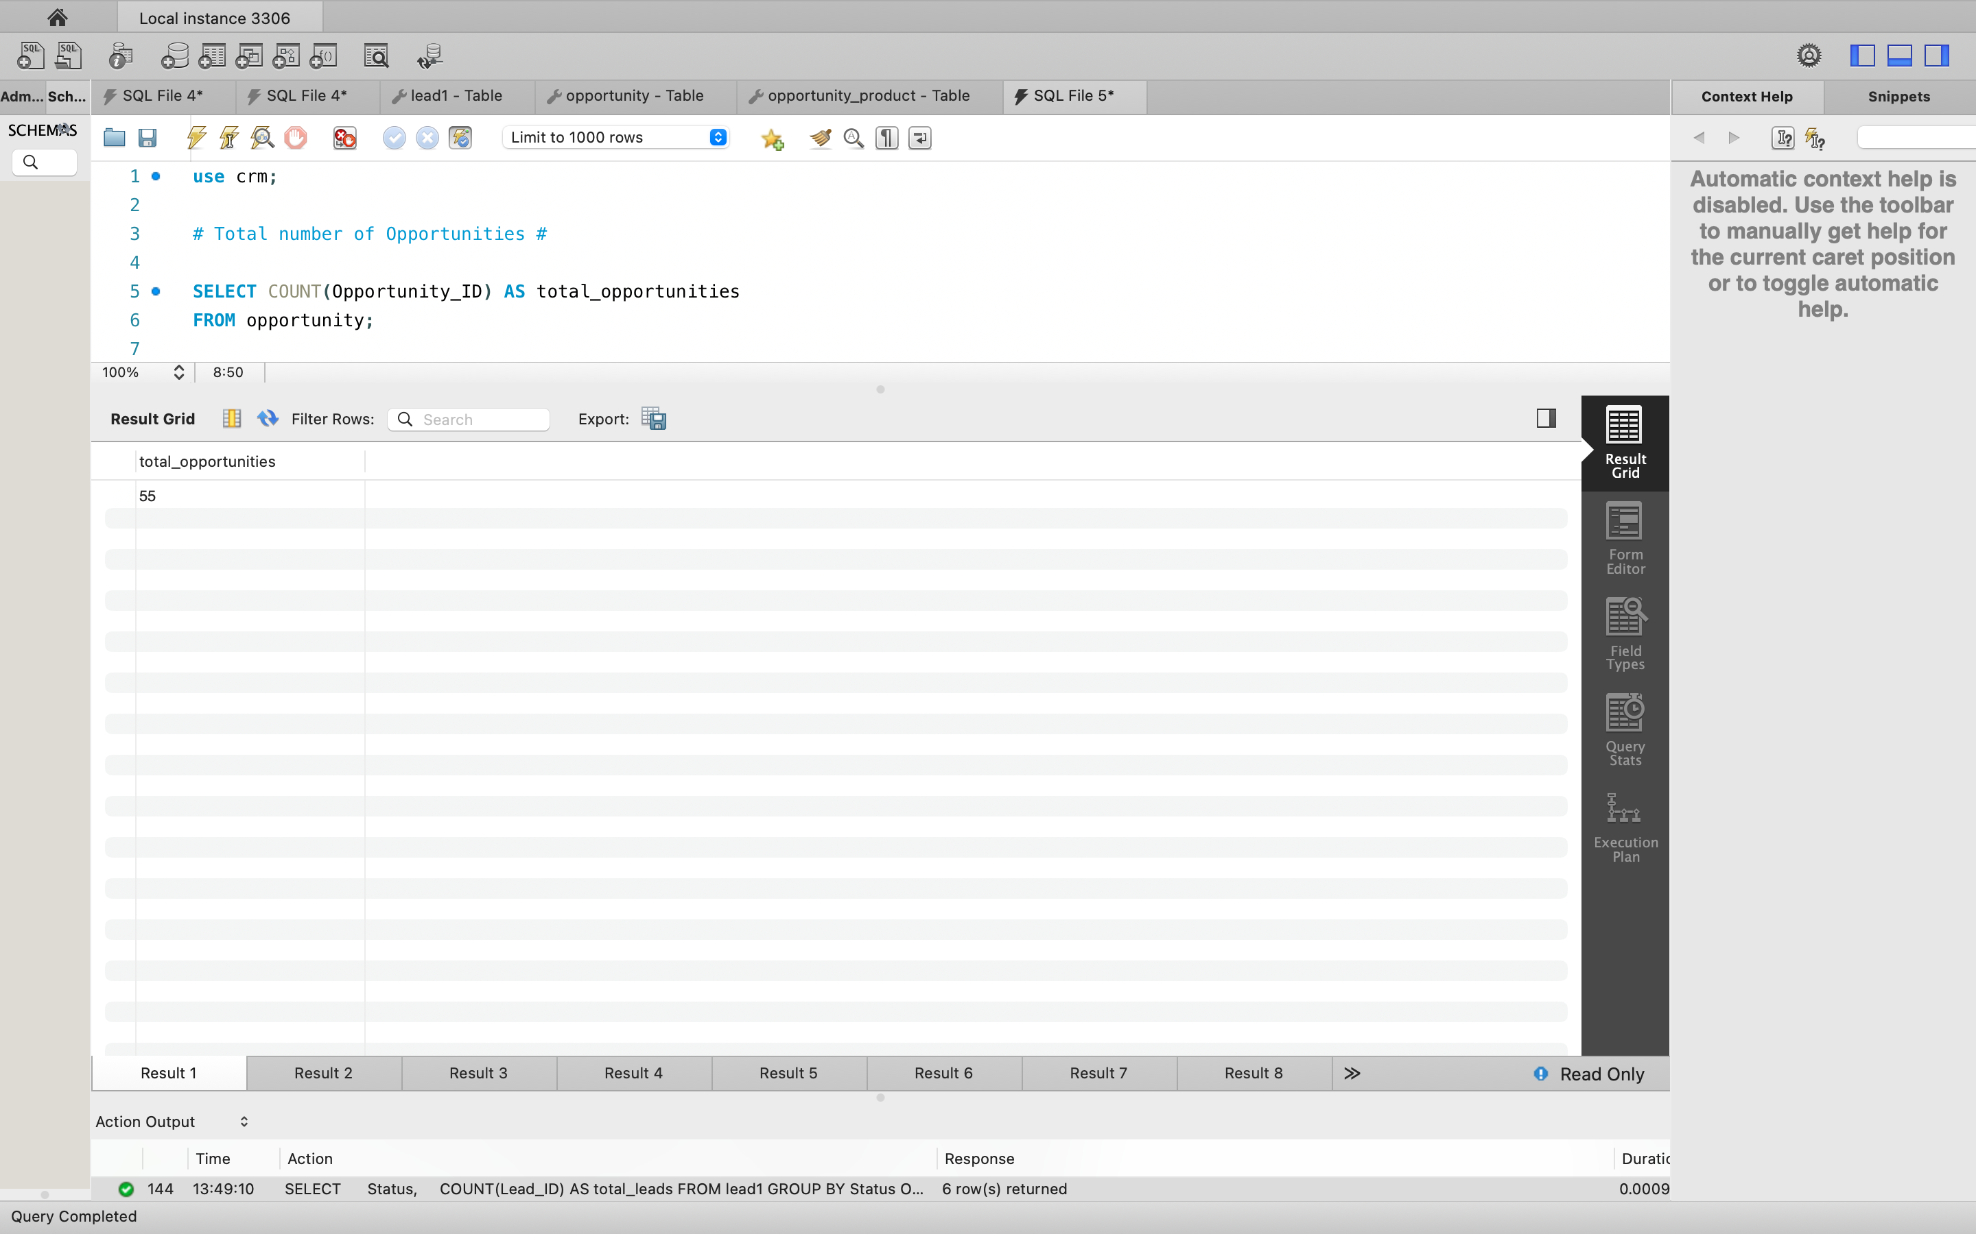
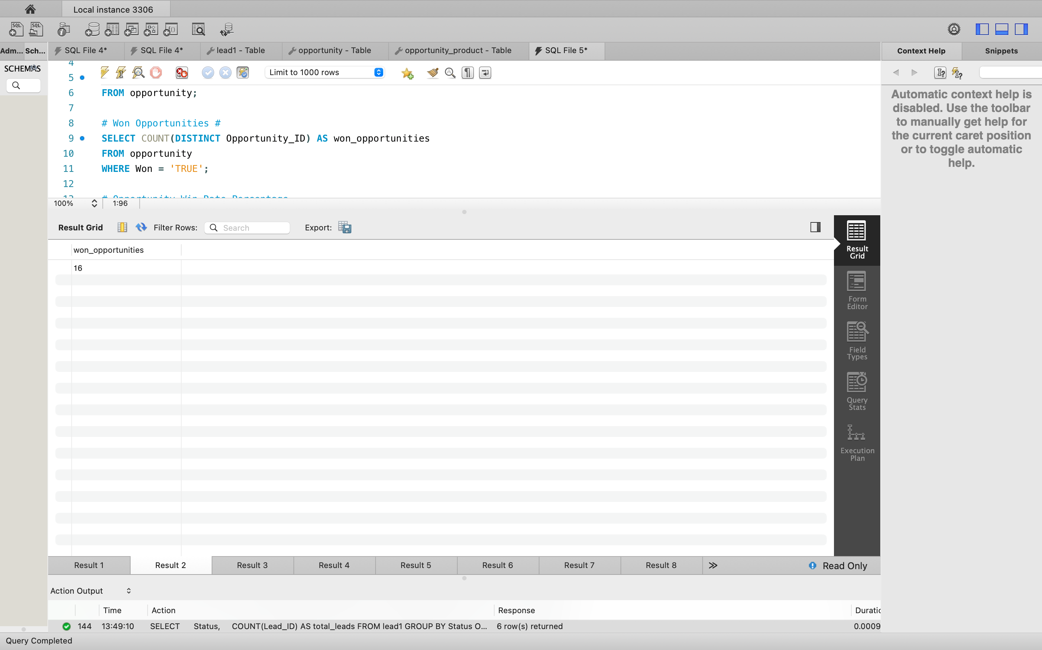
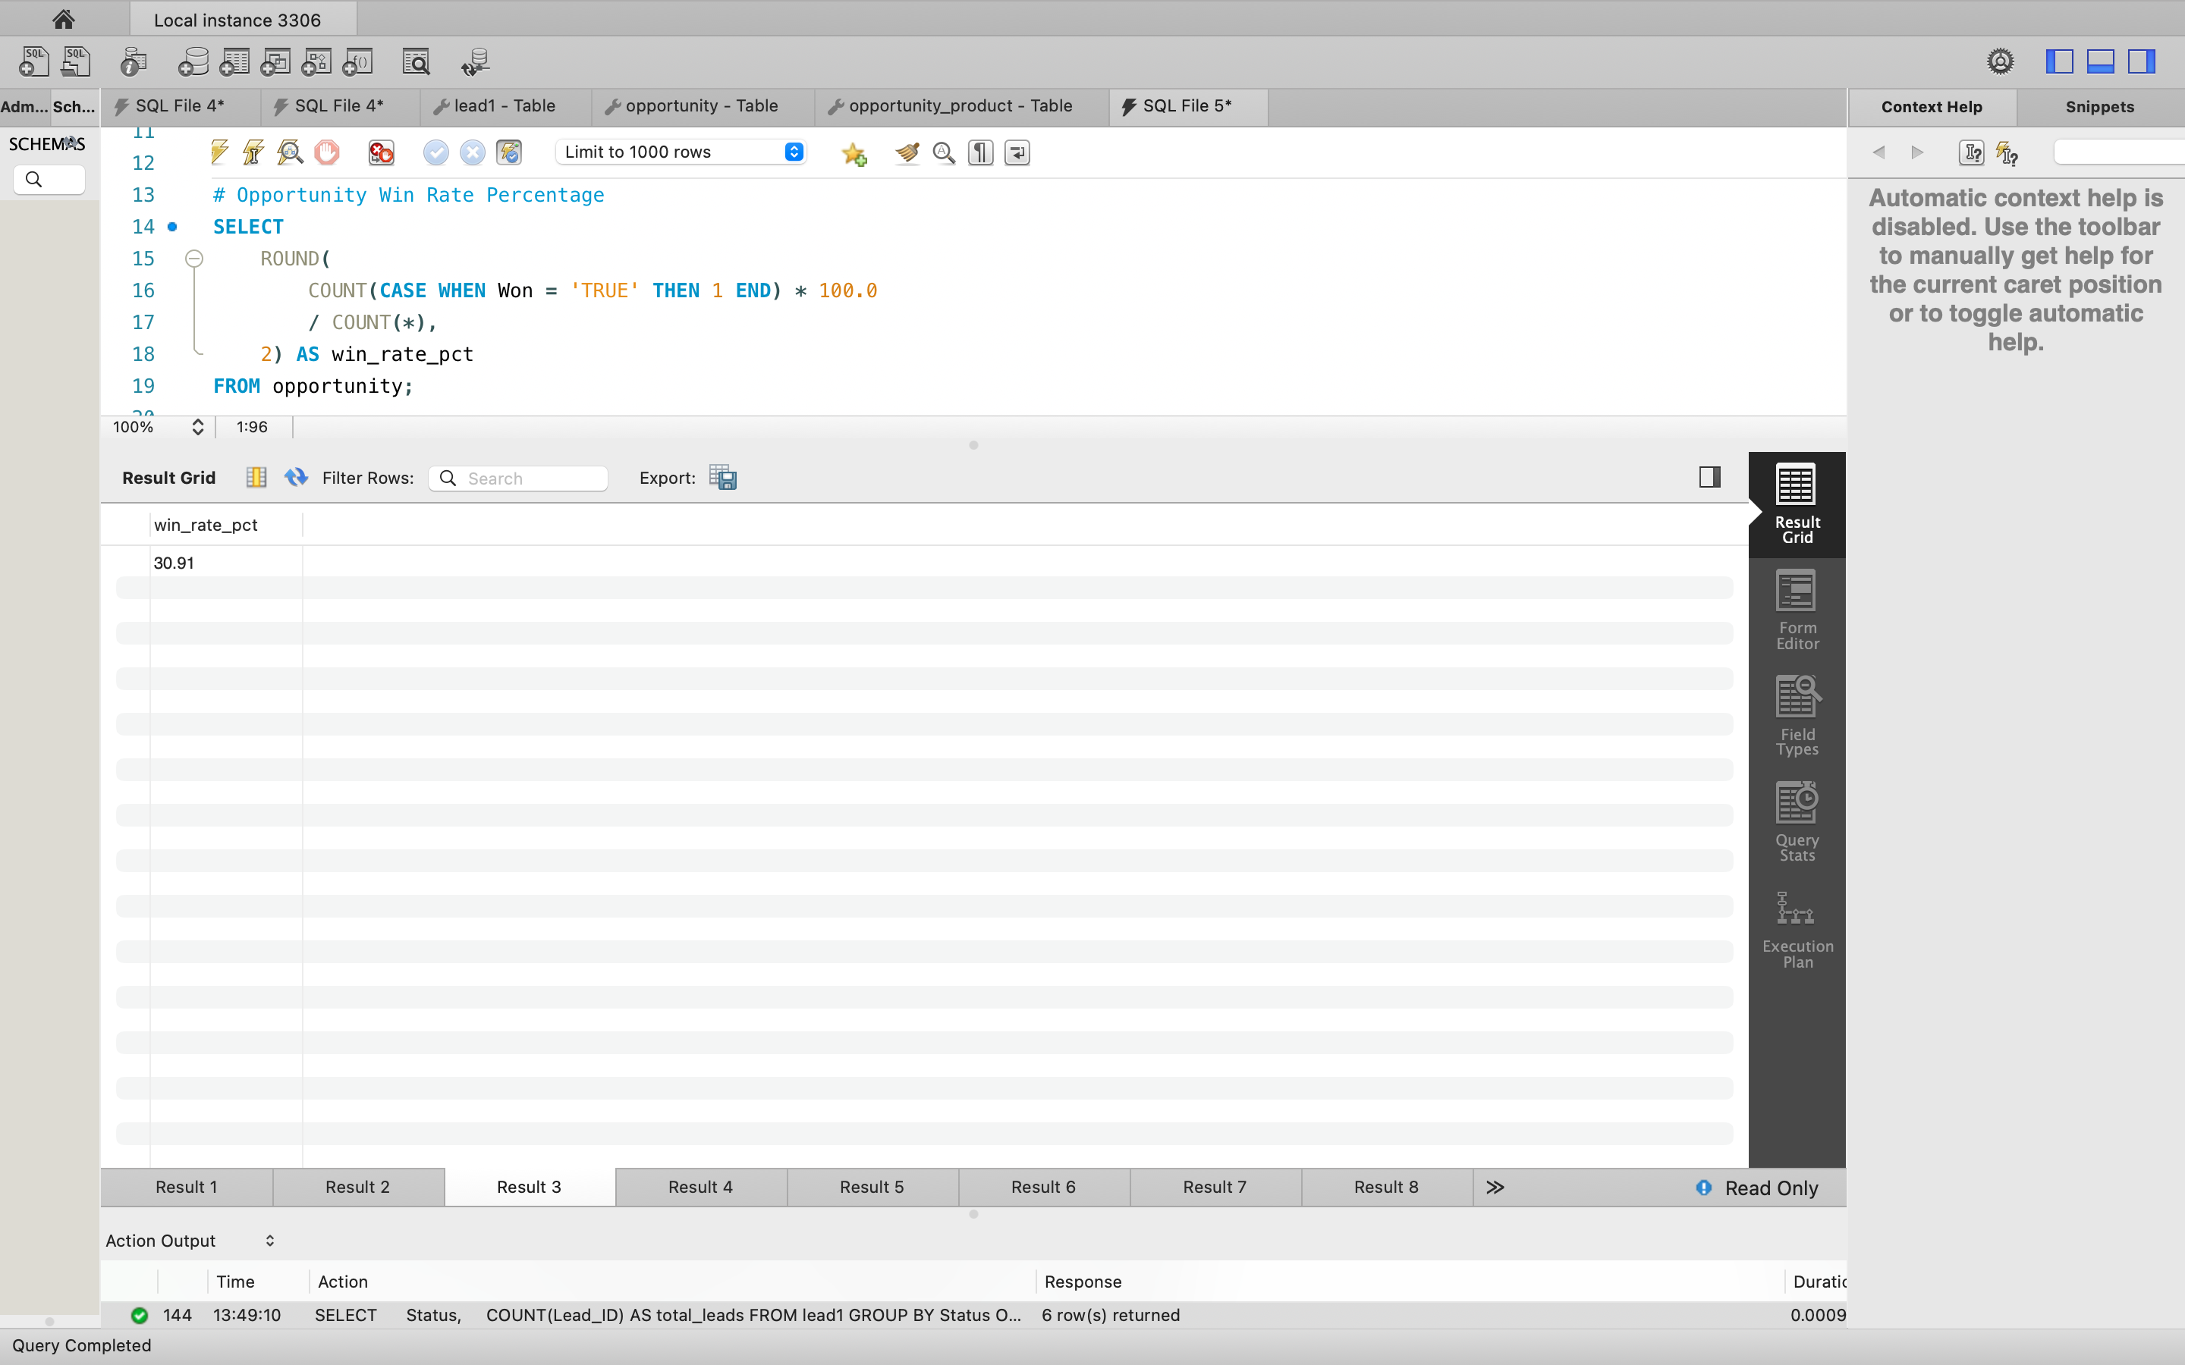
SQL QUERIES OUTPUT :

Slide 11
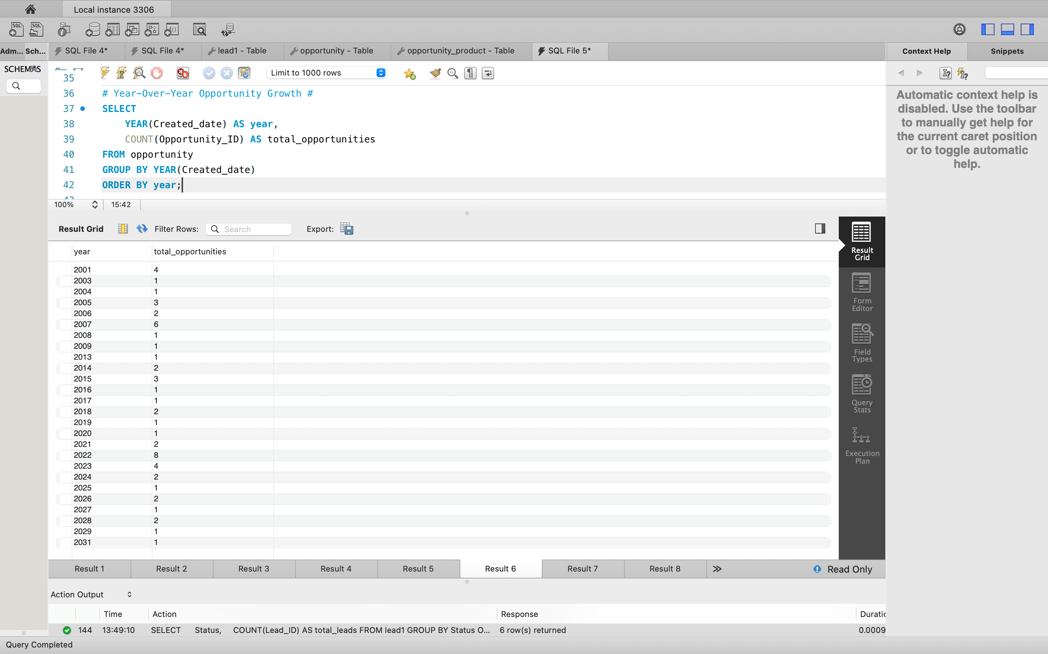
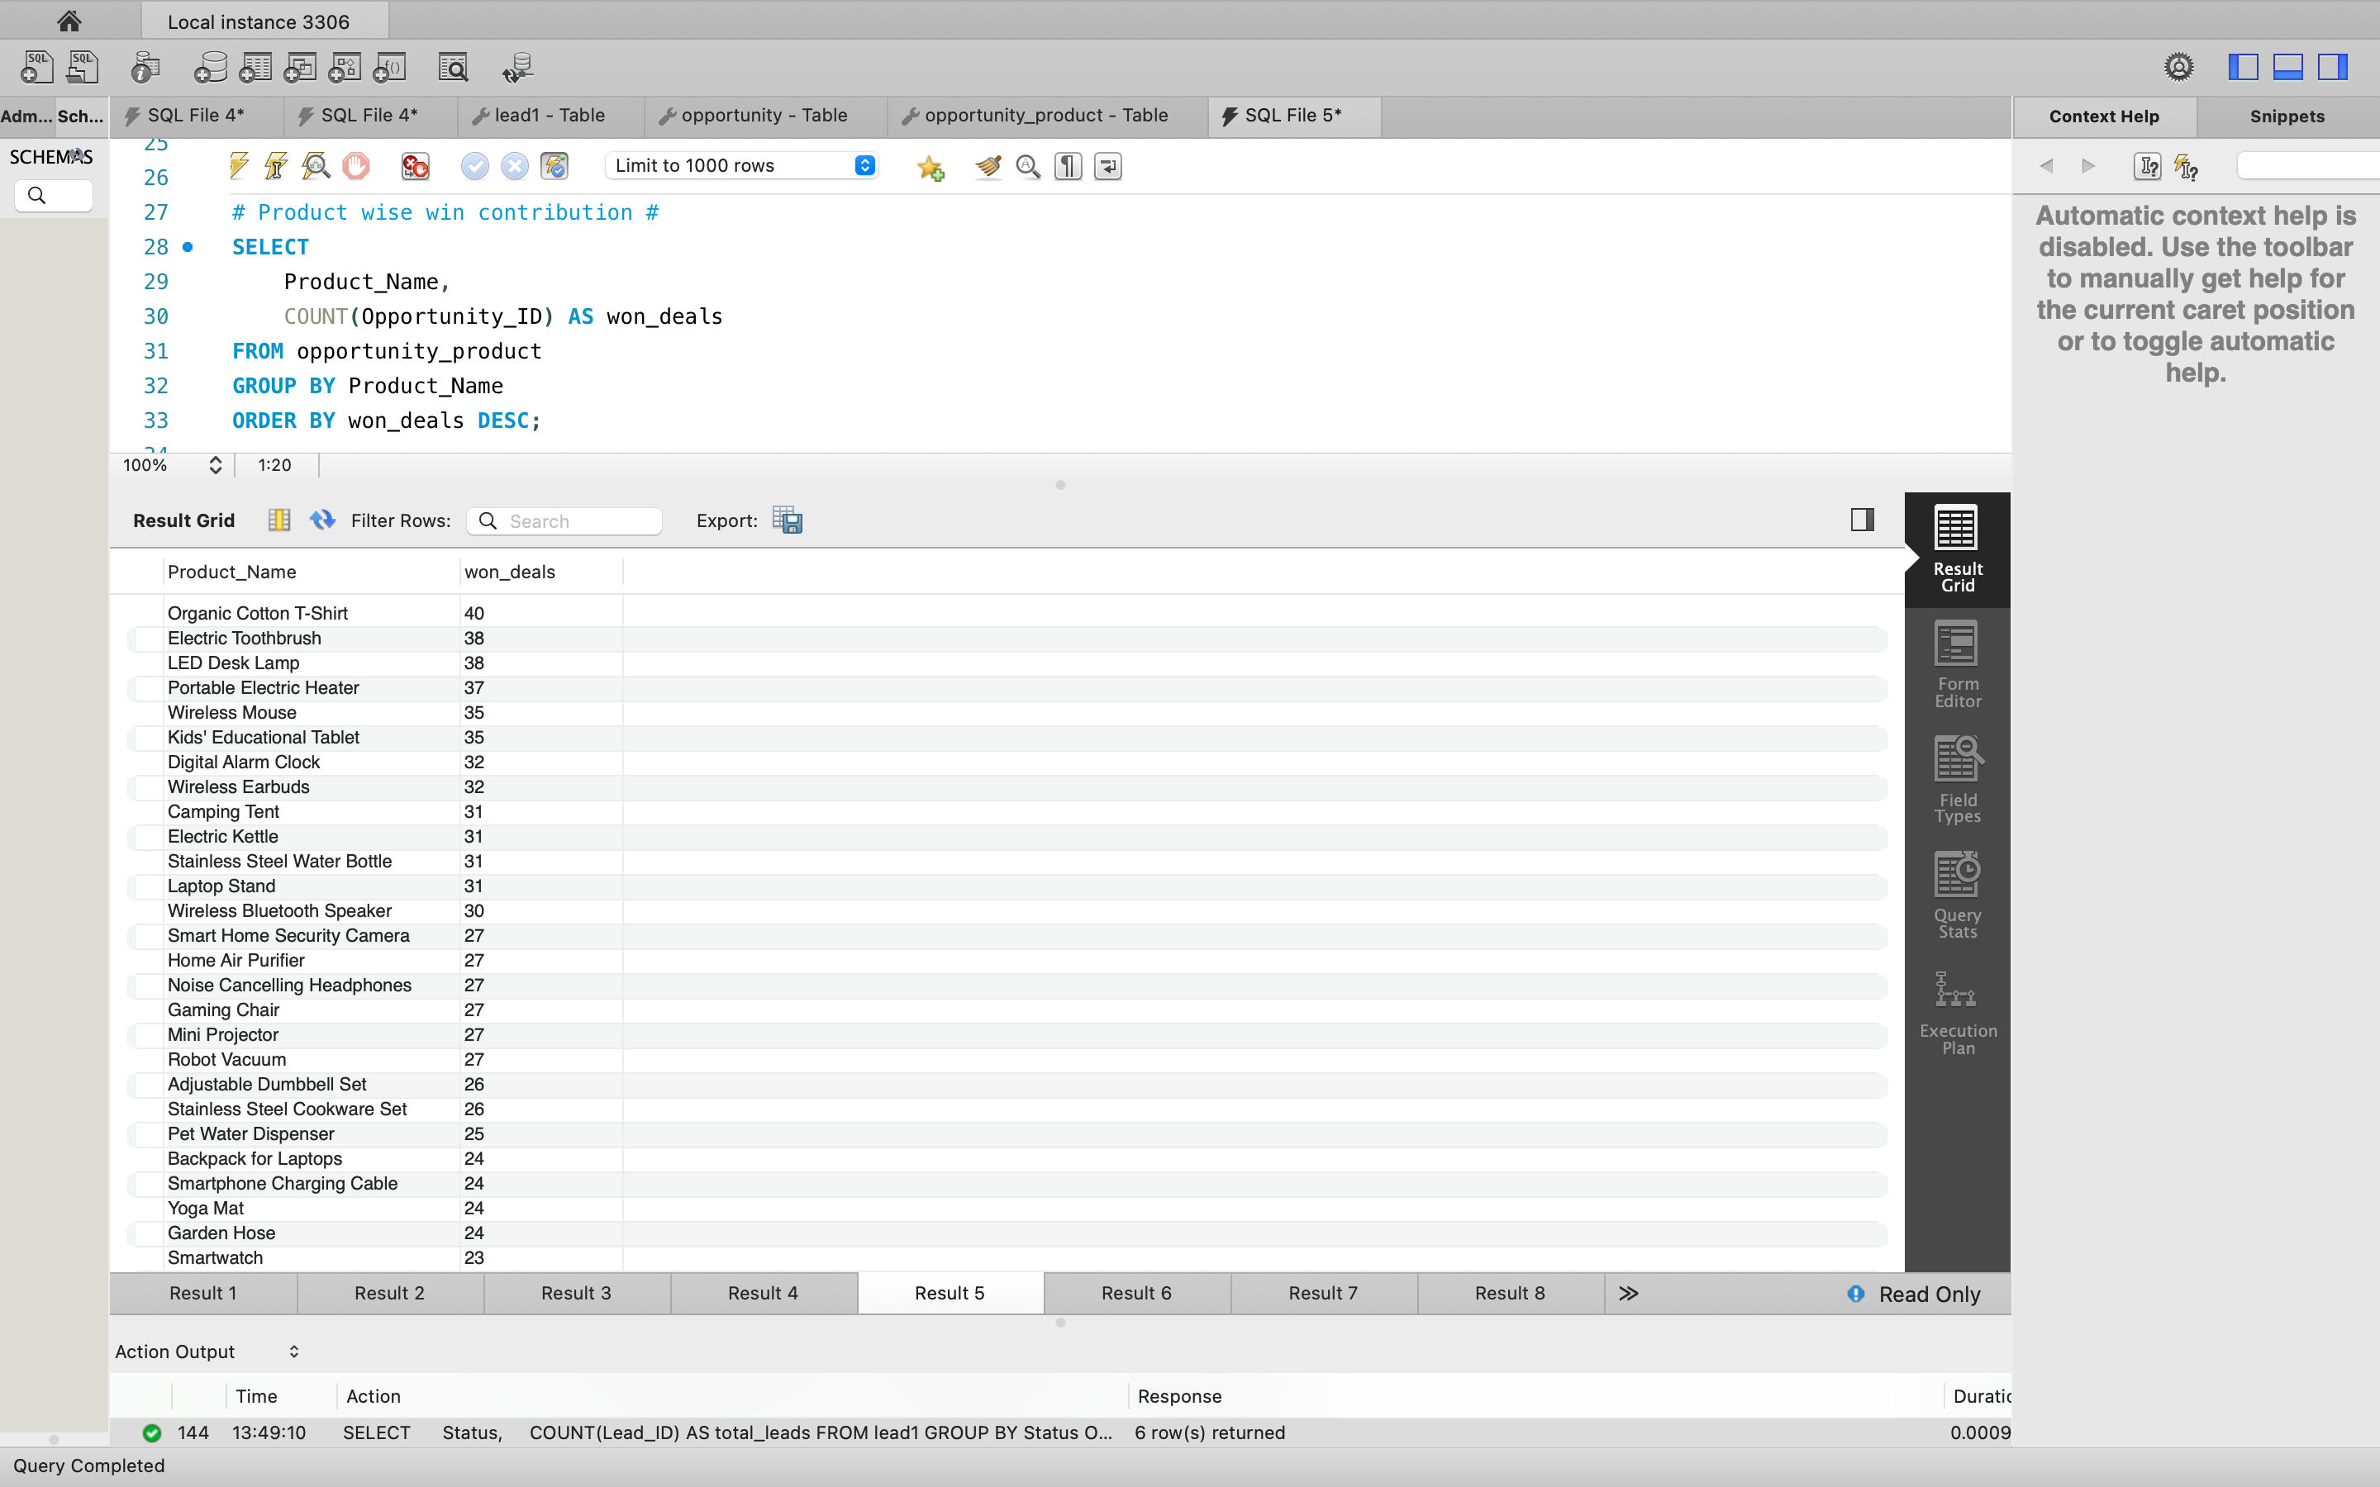

Slide 12
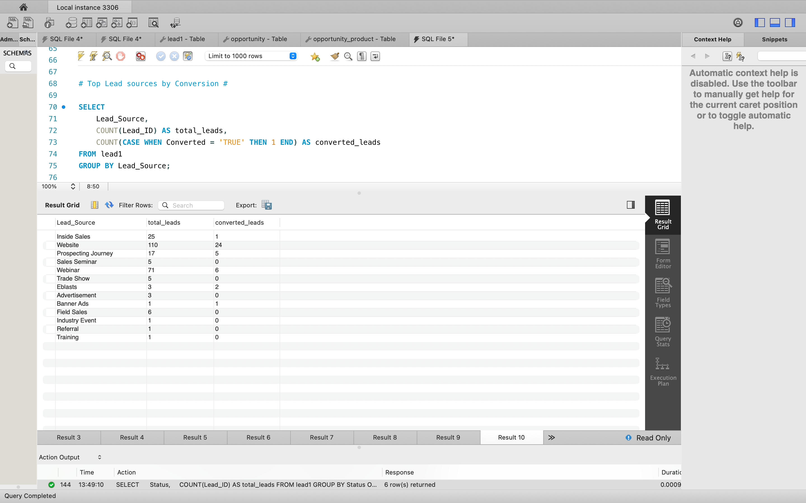
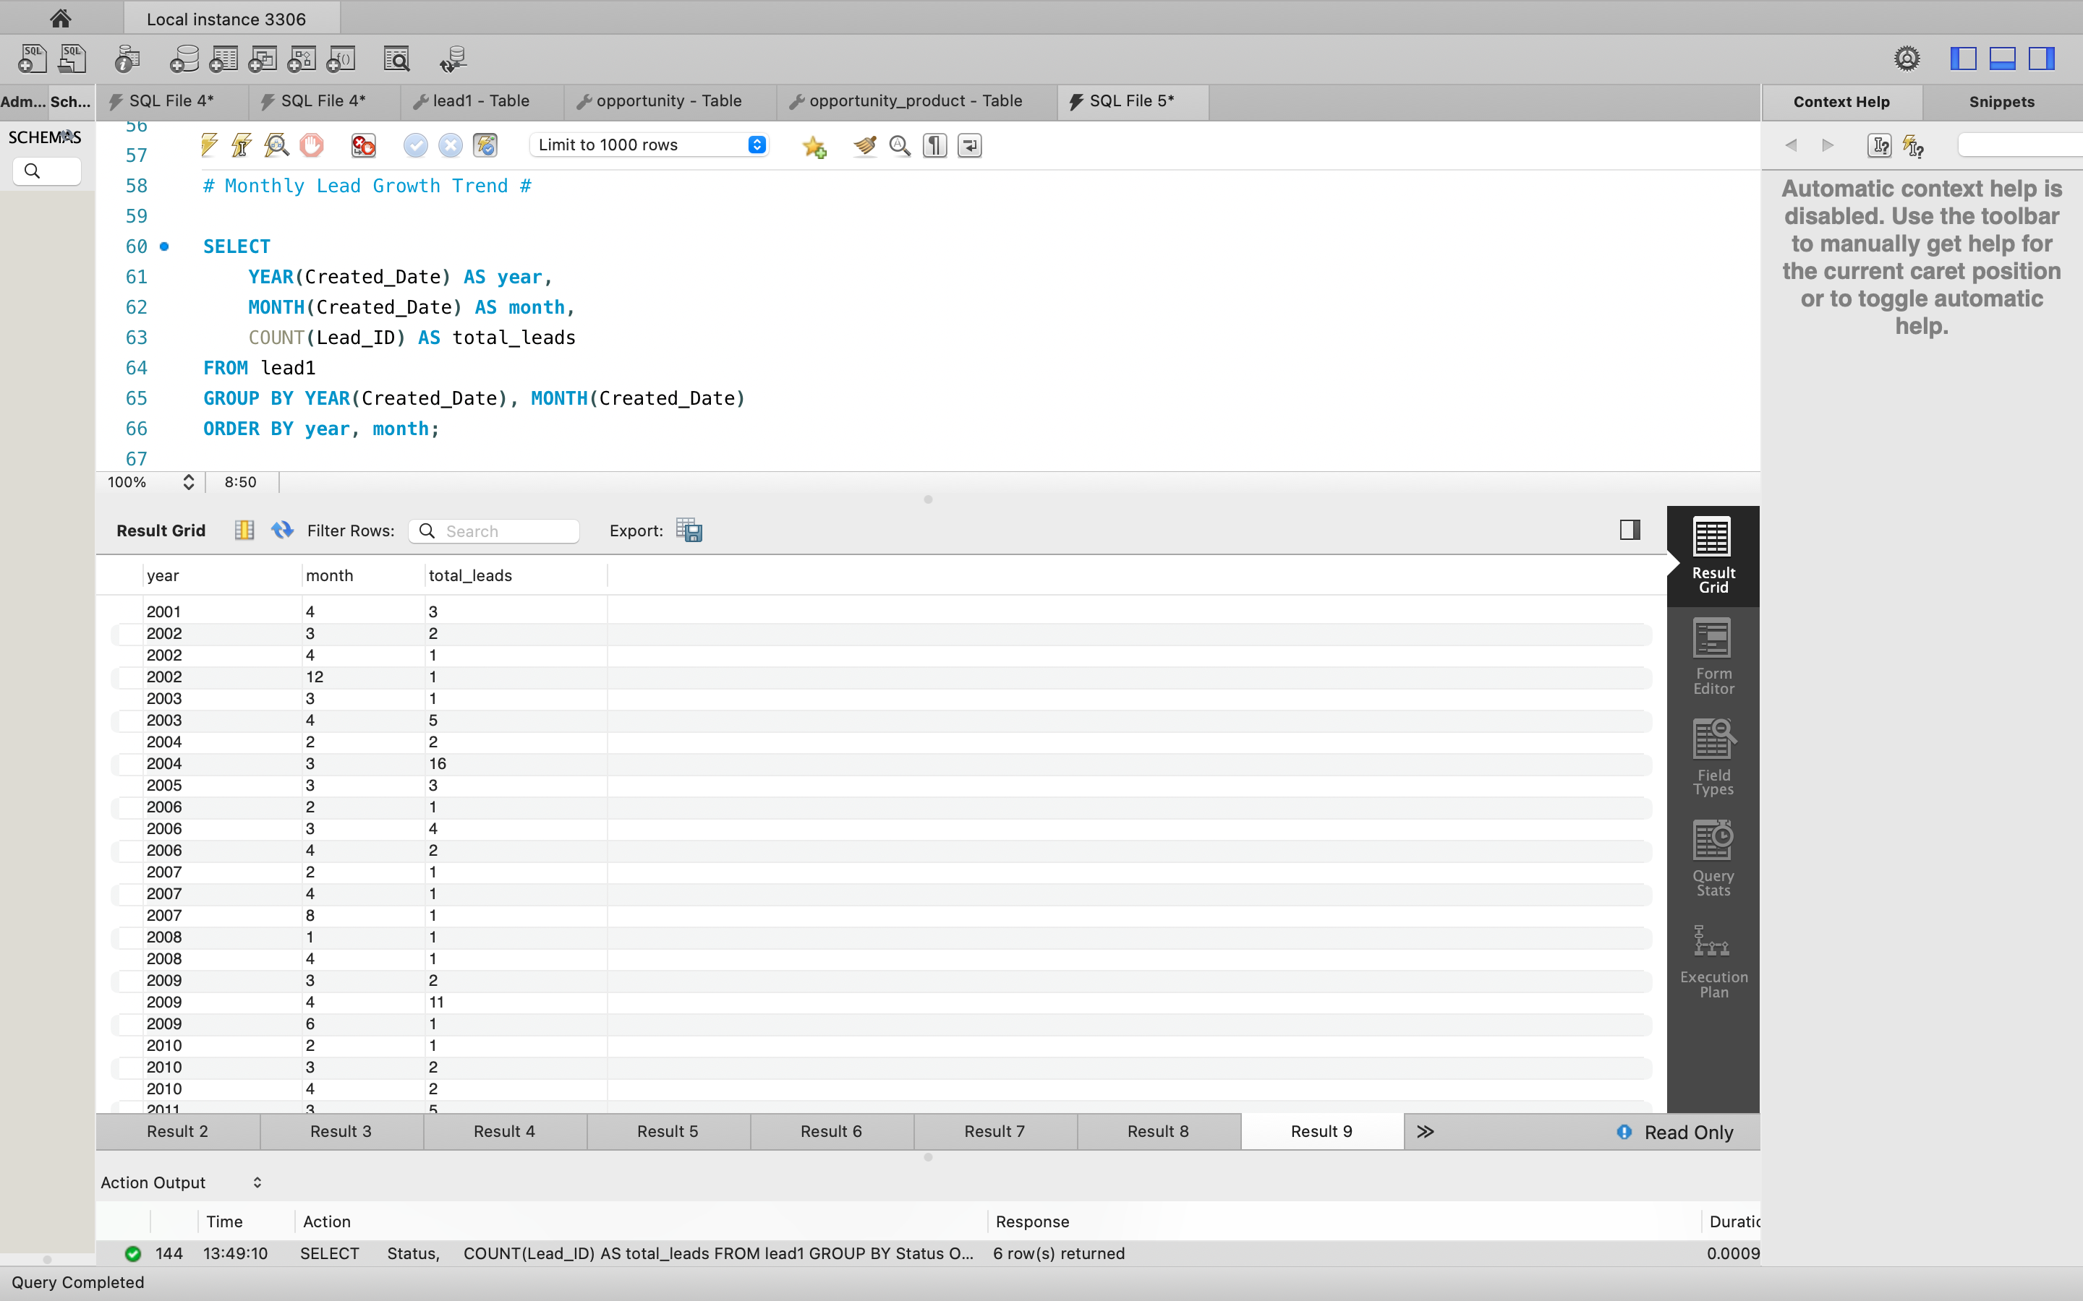
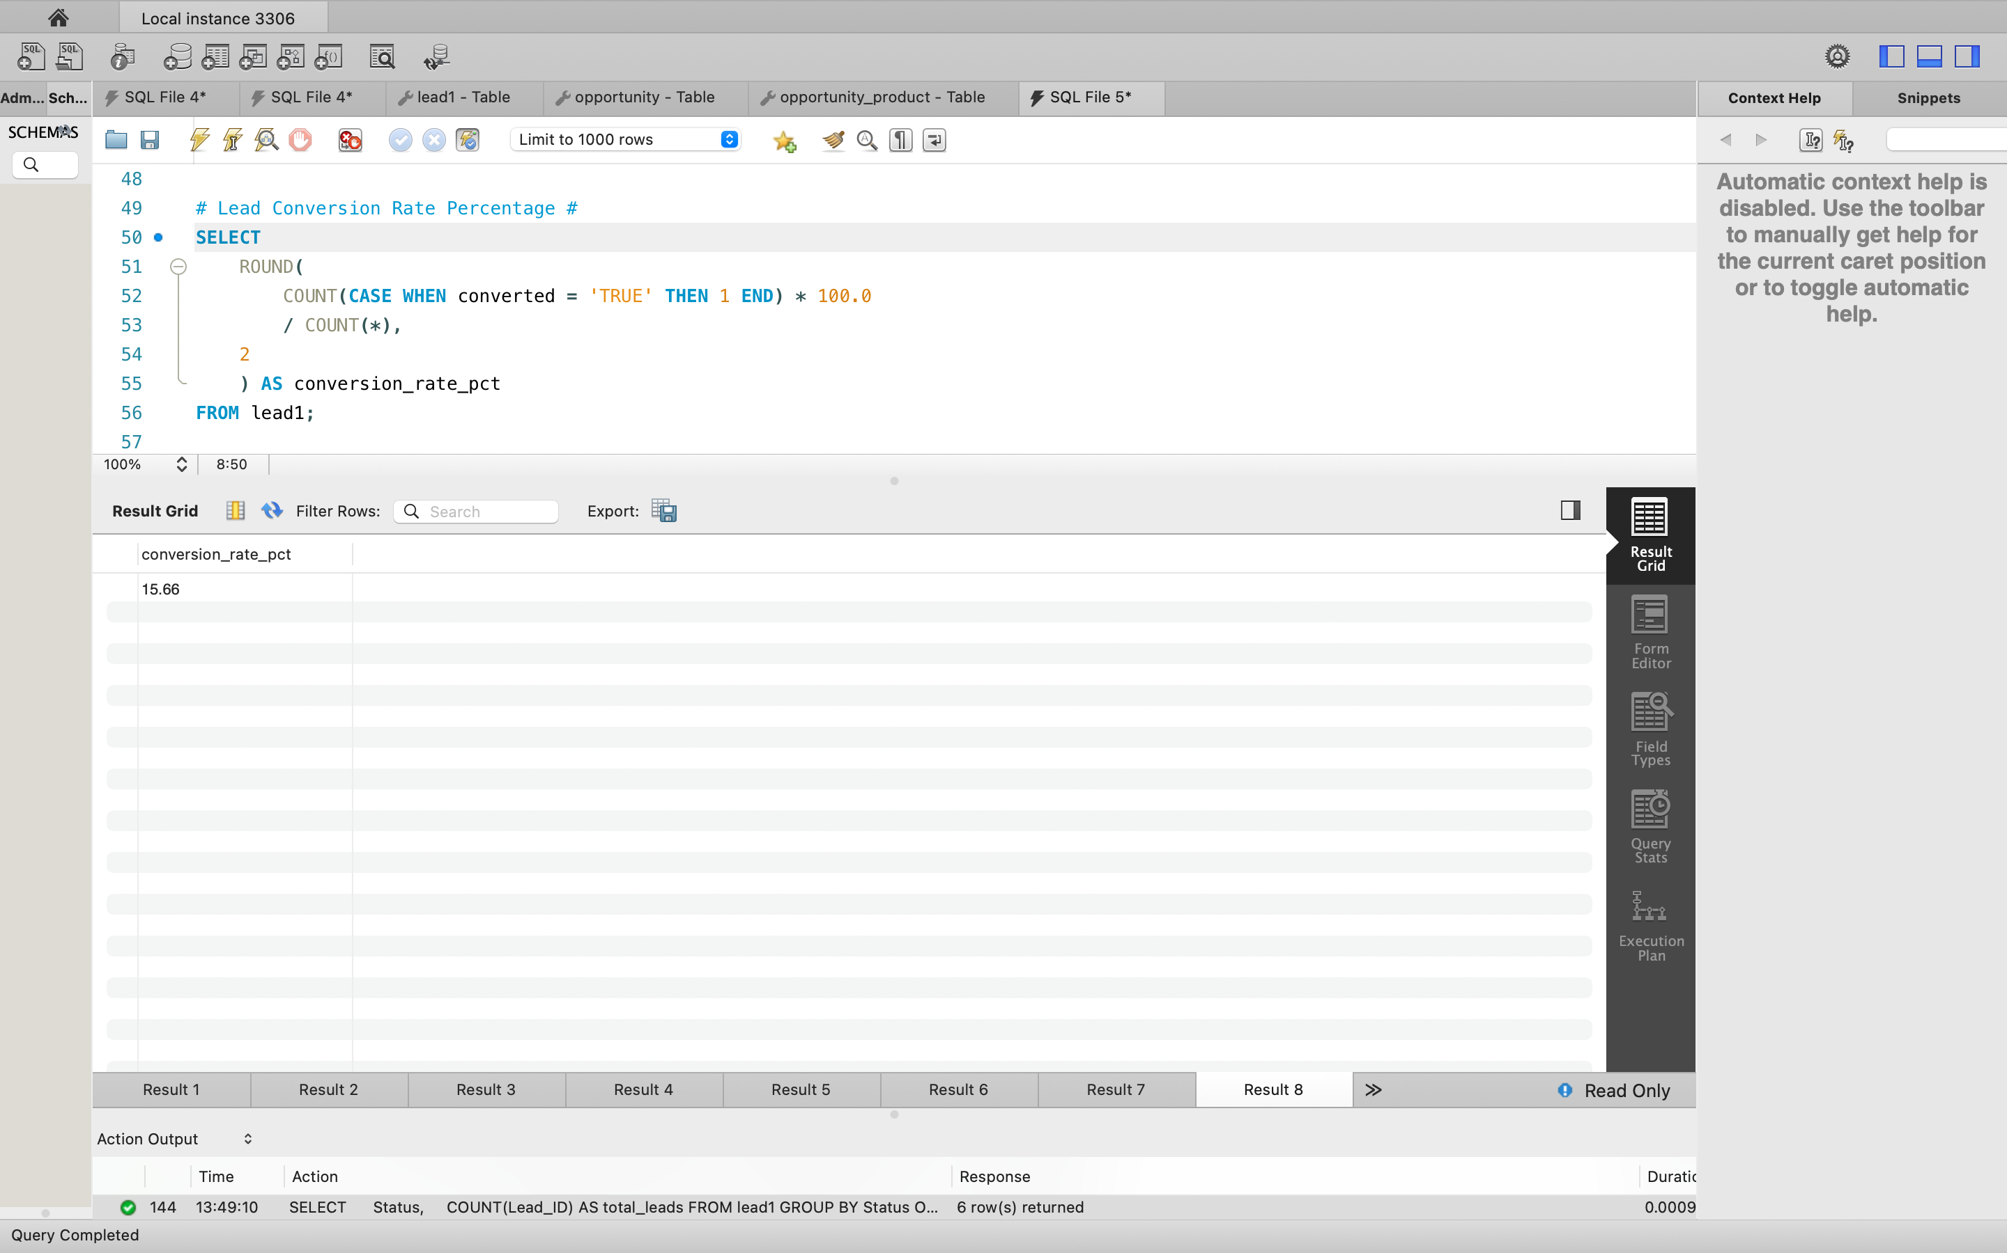

Slide 13
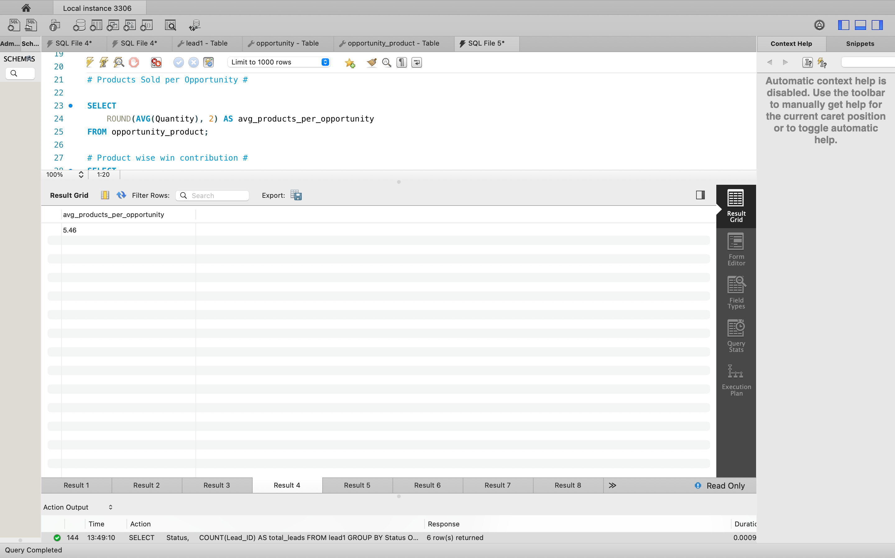
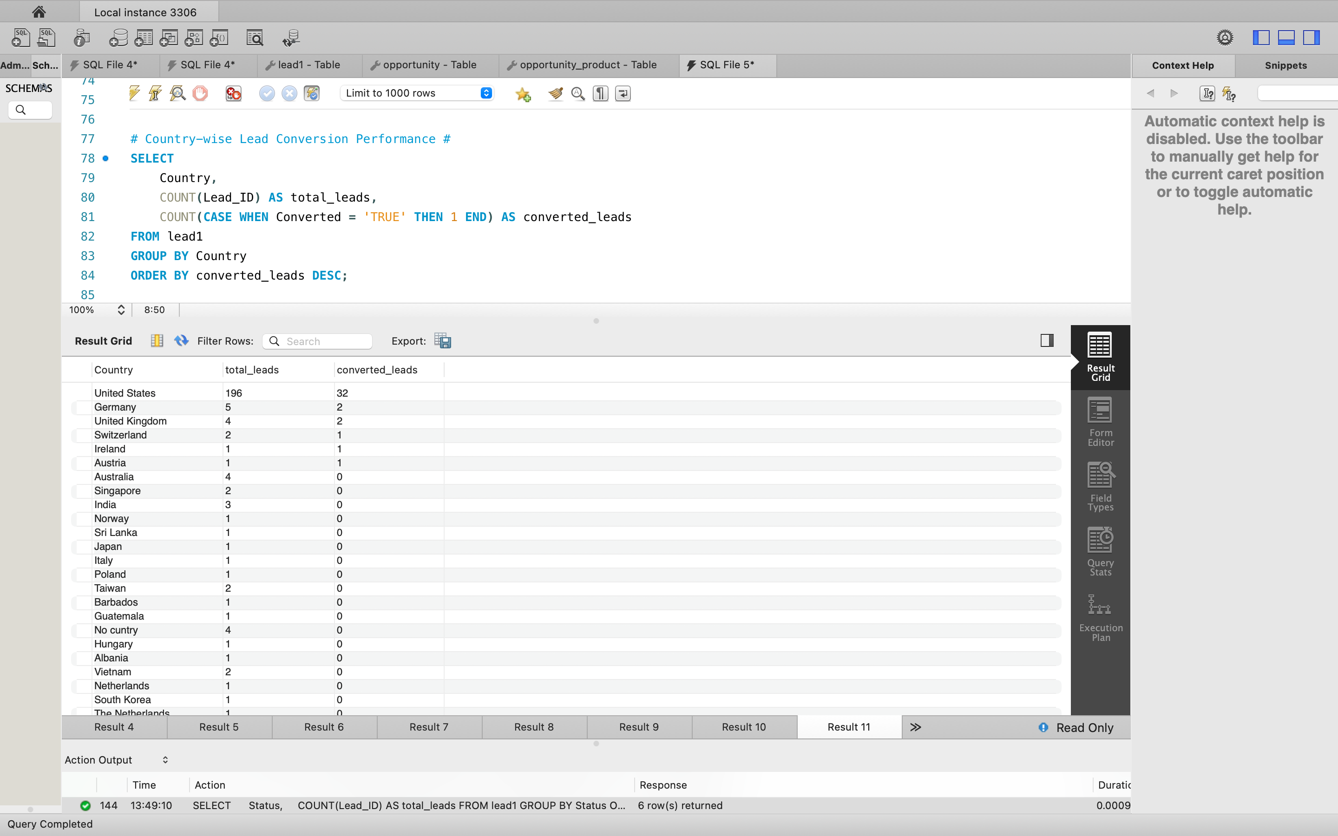
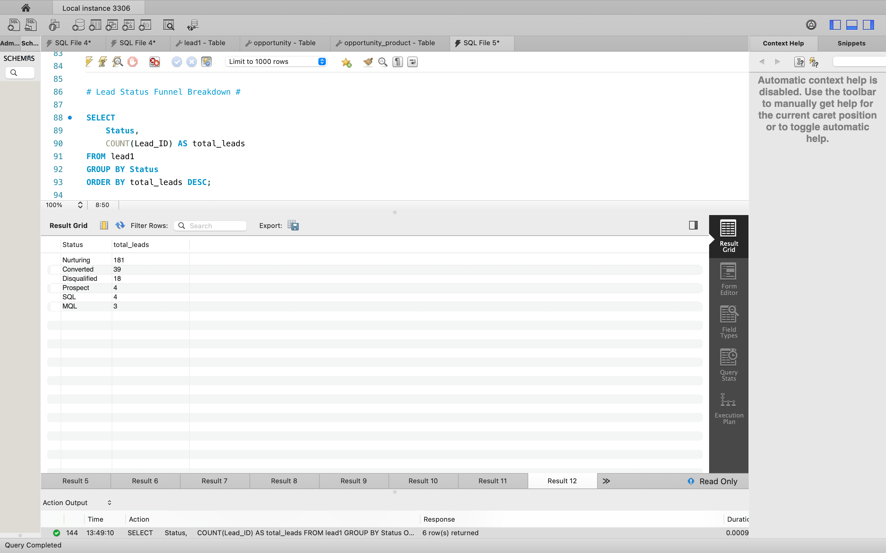

Slide 14
PROJECT SUMMARY:
This project focuses on Sales Analytics using Salesforce CRM data to analyze lead and opportunity performance.
The objective was to convert raw sales data into meaningful insights that support data-driven business decisions.
Power BI dashboards were created to monitor lead generation, lead conversion, opportunity stages, industry-wise performance, and regional analysis.
Tableau dashboards provided additional insights into lead behavior, product performance, discounts, lost reasons, and sales trends over time.
Key KPIs such as Total Leads, Converted Leads, Total Opportunities, Won Opportunities, and Product Sales were tracked using interactive dashboards.
The dashboards enable users to identify high-performing lead sources, products, industries, and regions, while also highlighting areas of improvement.
Interactive filters and drill-down capabilities allow stakeholders to analyze data from multiple perspectives.
Overall, the project demonstrates how Salesforce data combined with BI tools can improve sales visibility, efficiency, and strategic decision-making.

Slide 15




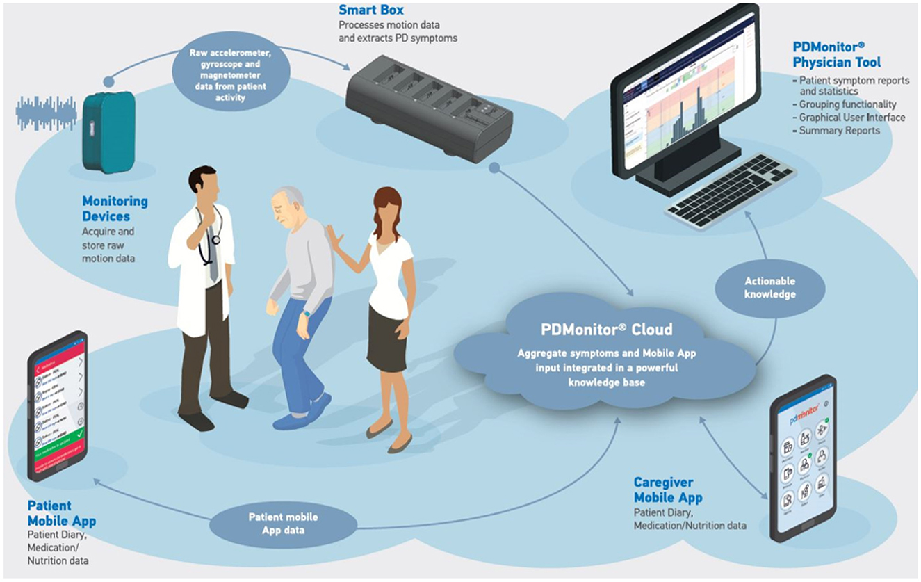
Growth and Efficiency improvement plan
Strengthen high-performing lead sources
Improve lead qualification process
Reduce opportunity loss reasons
Focus on high-demand products and Industries
Enable continuous monitoring and automation

Slide 16
THANK YOU

